Slide 1
Stack Overflow 2023 Survey Analysis
Investigation into the data that has been created by and for the Stack Overflow Community.

Slide 2
Understanding Respondents Demographics
Unders

Slide 3
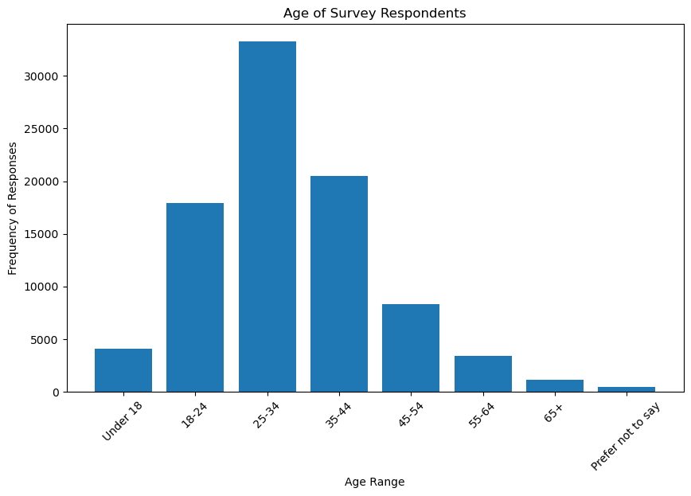
Age Distribution of Respondents

Slide 4
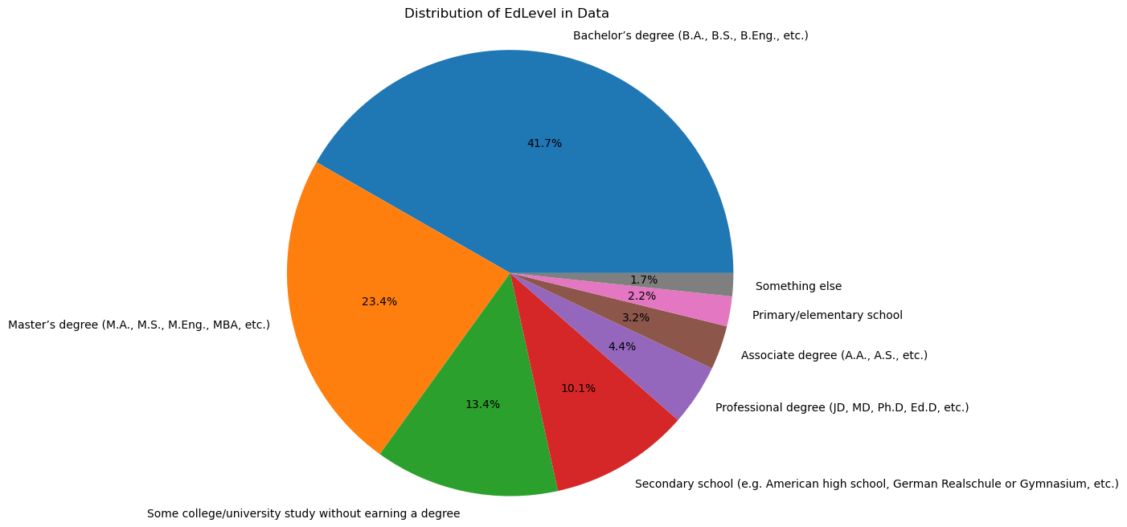
Education Level

Slide 5
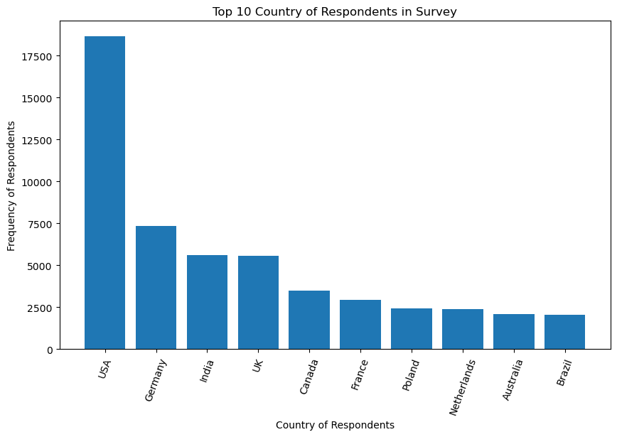
Country of Respondents

Slide 6
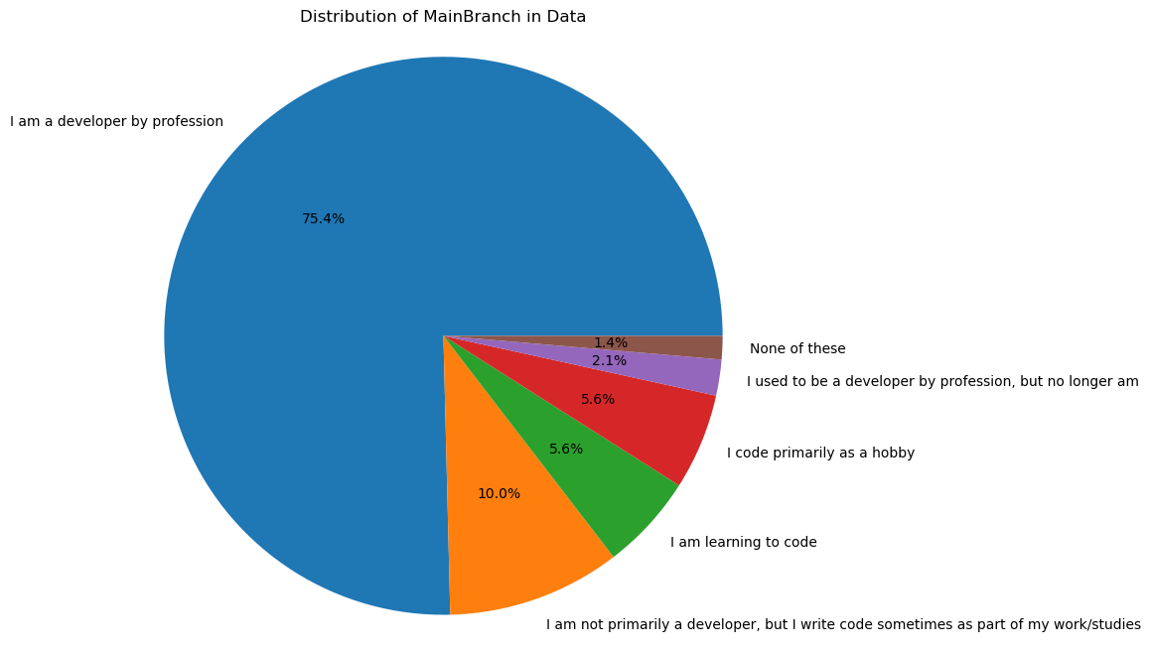
Code Use

Slide 7
Understanding Salary
Exploratory Data Analysis

